Slide 1
Sample Exercise Program Template
Aphasia-friendly toolkit March 2024
Disclaimer: These materials were created using funding from the Provincial Community Stroke Rehabilitation Initiative and crafted by Aran Oberle, Speech Language Pathologist, with input from regional rehab programs. They are not meant to replace professional expertise. Readers should seek advice from a qualified healthcare provider for any concerns. The content of this PowerPoint can be adjusted to suit the needs of healthcare professionals. Users are accountable for confirming the accuracy and suitability of the information for their unique situations.

Slide 2
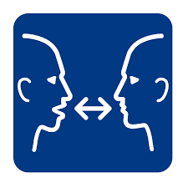
Exercise Program
Rehabilitation Post-Stroke
Title
1. Step 1
2. Step 2
3. Step 3
4. Step 4
Image support for Step 1
Image support for Step 2
Image support for Step 3
Image support for Step 4
Repeat ______ times

Slide 3
Guide d'entraînement
Réadaptation Post-AVC
Titre
1. Étape 1
2. Étape 2
3. Étape 3
4. Étape 4
Image de soutien
pour étape 1
Image de soutien
pour étape 2
Image de soutien
pour étape 3
Image de soutien
pour étape 4
Répétez ______ fois

