Slide 1
Sign Out Logbook
Aphasia-friendly toolkit March 2024
Disclaimer: These materials were created using funding from the Provincial Community Stroke Rehabilitation Initiative and crafted by Aran Oberle, Speech Language Pathologist, with input from regional rehab programs. They are not meant to replace professional expertise. Readers should seek advice from a qualified healthcare provider for any concerns. The content of this PowerPoint can be adjusted to suit the needs of healthcare professionals. Users are accountable for confirming the accuracy and suitability of the information for their unique situations.

Slide 2
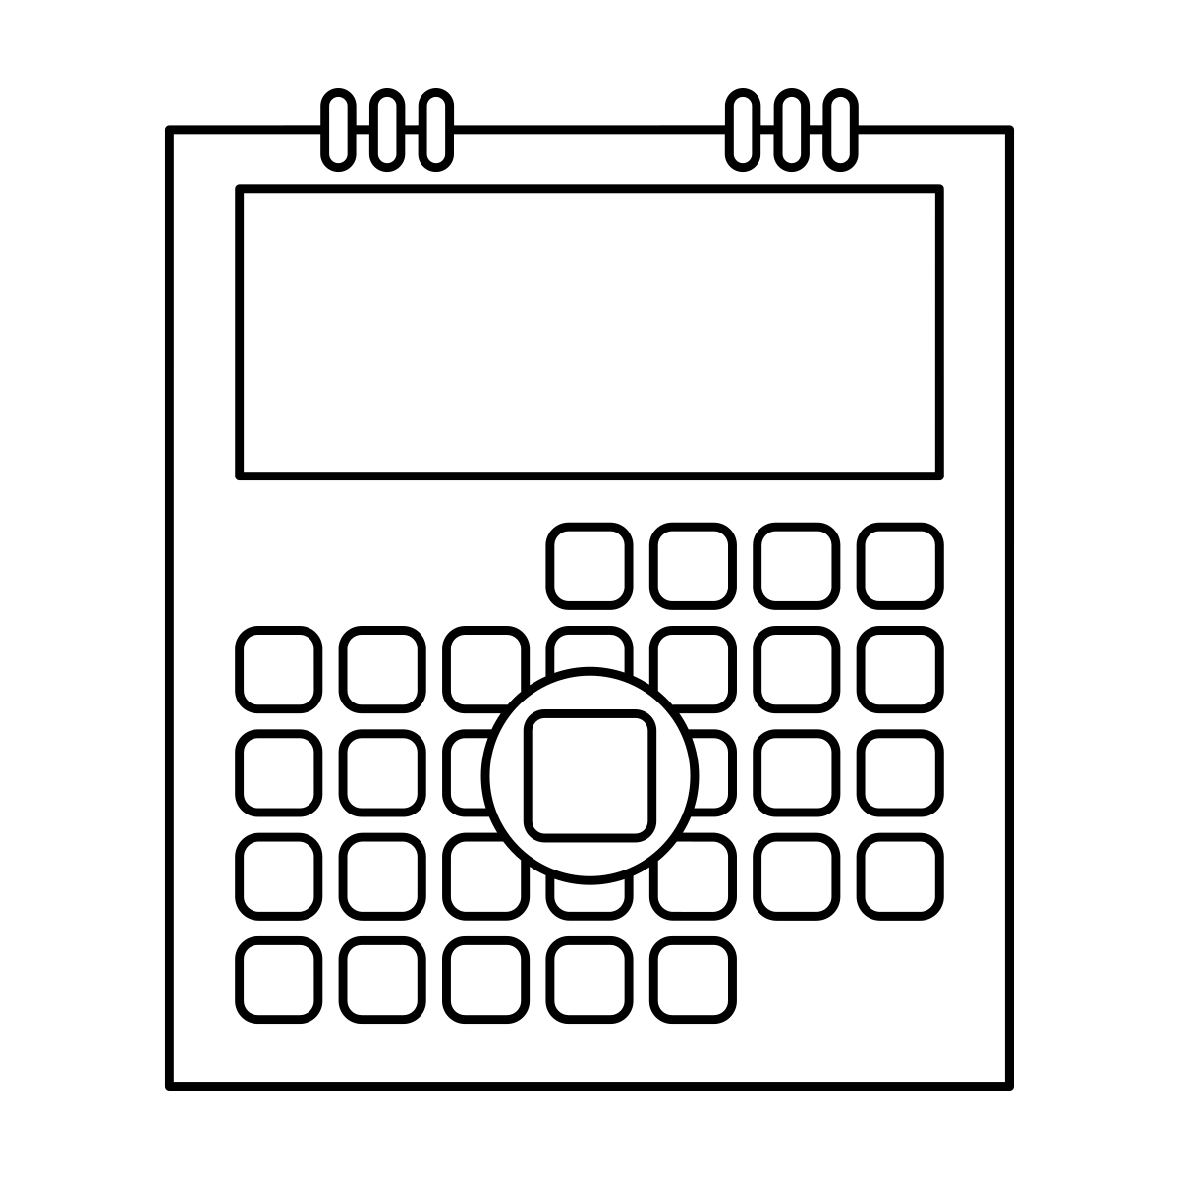
Date DD/MM/YYYY JJ/MM/AAAA | Name Nom | With Who? Avec Qui? | Where? Où? | Sign OUT Time Heure de sortie | Return Time Plan Heure de retour planifiée | Return Time Heure de retour | Initials Initiales
_ _ / _ _ / _ _ _ _
_ _ / _ _ / _ _ _ _
_ _ / _ _ / _ _ _ _
_ _ / _ _ / _ _ _ _
_ _ / _ _ / _ _ _ _
_ _ / _ _ / _ _ _ _
_ _ / _ _ / _ _ _ _
_ _ / _ _ / _ _ _ _
_ _ / _ _ / _ _ _ _
22 01 2024
John Smith
Lucy Smith
Walking outside
1:30 pm
2:15 pm
J.S.

Slide 3
Date DD/MM/YYYY JJ/MM/AAAA | Name Nom | With Who? Avec Qui? | Where? Où? | Sign OUT Time Heure de sortie | Return Time Plan Heure de retour planifiée | Return Time Heure de retour | Initials Initiales
_ _ / _ _ / _ _ _ _
_ _ / _ _ / _ _ _ _
_ _ / _ _ / _ _ _ _
_ _ / _ _ / _ _ _ _
_ _ / _ _ / _ _ _ _
_ _ / _ _ / _ _ _ _
_ _ / _ _ / _ _ _ _
_ _ / _ _ / _ _ _ _
_ _ / _ _ / _ _ _ _
22 01 2024
John Smith
Lucy Smith
Walking outside
1:30 pm
2:15 pm
J.S.

Slide 4
Livre de SORTIE
SIGN OUT Book

Slide 5
Livre de SORTIE
SIGN OUT Book

